Slide 1

iSchool (E-Learning Management System)
Project by Priyanka Dilip Marathe
MCA Final Year Project
Academic Year 2024 – 2025

Slide 2

Index
Introduction
Company Profile
System Requirements Analysis
System Design
Website Design
Database Design
7. Motivation
8. Conclusion

Slide 3
1. INTRODUCTION
Project: iSchool
LMS developed for Unified Mentor.
Enables course registration, purchase, feedback.
Admin panel and student dashboard.
Easy access to educational resources online.

Slide 4
2. COMPANY PROFILE
Unified Mentor is a leading provider of online certification courses and live training programs. Its mission is to bridge the gap between academic learning and industry needs by offering practical, job-oriented education.
Key Services Offered:
Data Science
Full Stack Web Development
Machine Learning
Digital Marketing
UI/UX Design

Slide 5
Highlights:
Interactive, project-based learning approach
Real-world project exposure
Strong focus on employability and social impact
Unified Mentor is committed to empowering learners from diverse backgrounds through skill – based education.

Slide 6
3. SYSTEM REQUIREMENTS
Web application (PHP, MySQL)
Admin & Student modules
Features: Registration, Login, Course Management
Security: Authorized access only
Requirement: Browser + Internet

Slide 7
4.1 USE CASE DIAGRAM
A Use Case Diagram represents the interactions between users (actors) and the system. It shows what the system does (functions) from the user's perspective.
Main Actors:
Admin: Manages courses and student data
Student: Registers, buys courses, views lessons, gives feedback
Key Use Cases:
Login / Register
Purchase Course
Watch Video Lessons
Add / Manage Courses (Admin)
Submit Feedback

Slide 8
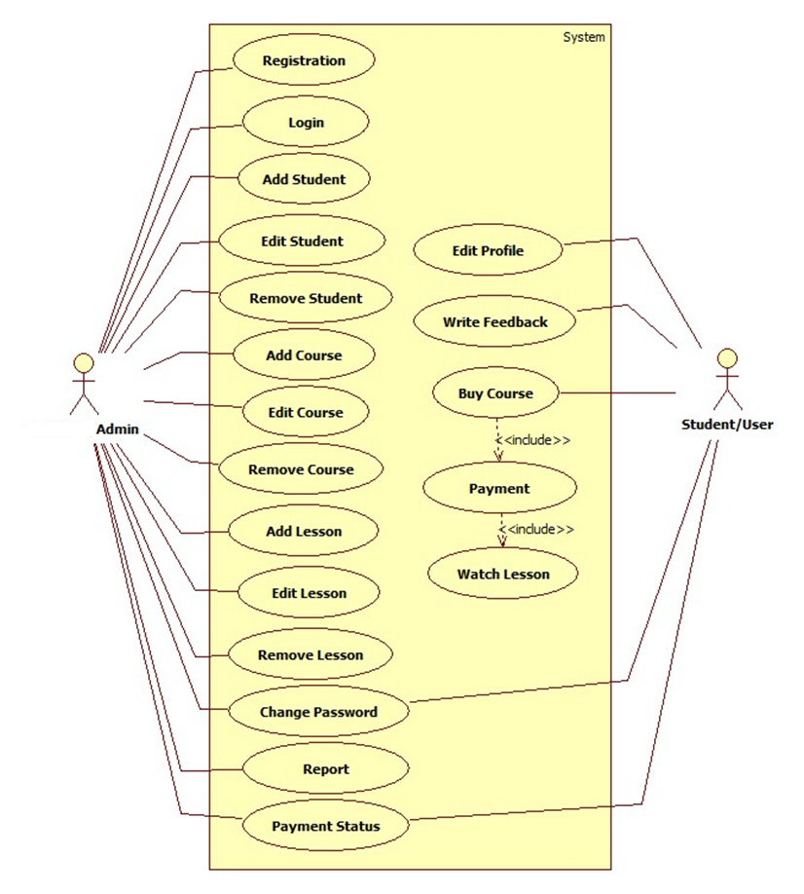

Slide 9
4.2 DFD DIAGRAMS
Data flow diagram is graphical representation of flow of data in an information system. It uses defined symbols like rectangles, circles and arrows, plus short text labels, to show data inputs, outputs, storage points and the routes between each destination. Data flowcharts can range from simple, even hand-drawn process overviews, to in-depth, multi-level DFDs that dig progressively deeper into how the data is handled.
Level 0: Overall System
Level 1: Course & User Functions
Level 2: Detailed student & admin operations

Slide 10
DFD 0 LEVEL
The 0 Level DFD shows flow of data of application. DFD Level 0 is also called a Context Diagram. It’s a basic overview of the whole system or process being analysed or modelled.
Watch Course
Student / Learner
Admin
Report
Buy Course
Upload Couse
iSchool
(E-Learning
Management
System)

Slide 11
DFD 1 LEVEL
DFD Level 1 provides a more detailed breakout of pieces of the Context Level Diagram. This DFD describes main functions carried out by the system, as we break down the high – level process of the Context Diagram into its sub – processes.

Slide 12
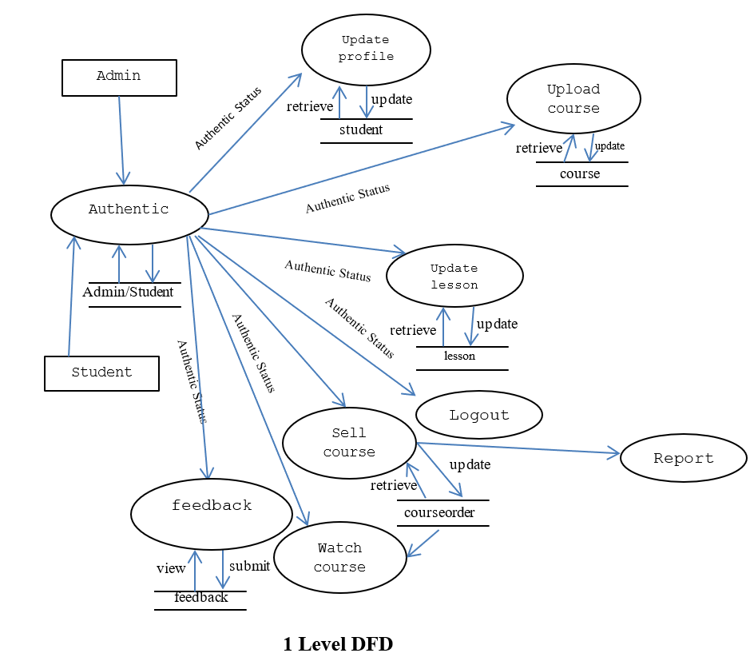

Slide 13
DFD 2 LEVEL
The DFD 2 Level describes flow of data in more detail. DFD Level 2 goes one step deeper into parts of Level 1. It may require more text to reach the necessary level of detail about the system’s functioning.

Slide 14
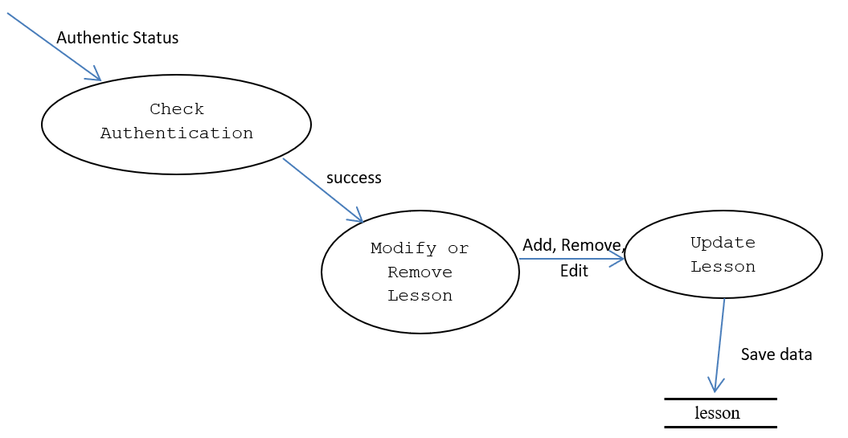

Slide 15
4.3 ENTITY RELATIONSHIP DIAGRAM
An Entity Relationship Diagram (ERD) is a visual representation of different entities within a system and how they relate to each other.
Entities:
Admin, Student, Course, Lesson, Feedback, Orders
Relationships:
One-to-many (e.g. Admin -> Courses)
Ensures database normalization

Slide 16
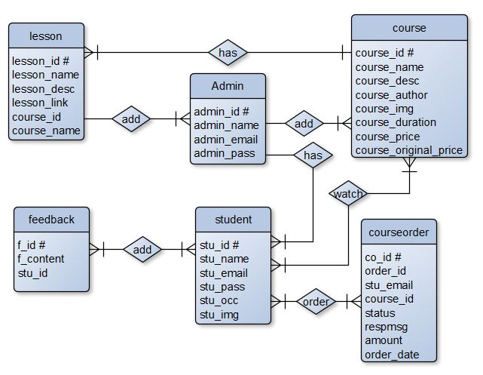

Slide 17
4.4 FLOWCHARTS
A flowchart is a visual diagram used to represent a process, system, or algorithm. It simplifies complex workflows using standard symbols like ovals (start / end), rectangles (process), and diamonds (decision), connected by arrows to show sequence and flow. Flowcharts are widely used for planning, analyzing, and improving processes across various fields.
Includes:
Login Flow
Add Lesson Flow
Payment Flow
Visual representation of decision-making logic

Slide 18
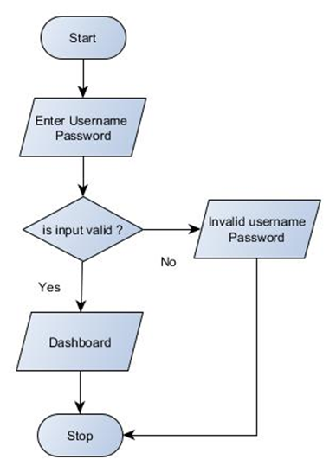
LOGIN FLOW CHART

Slide 19
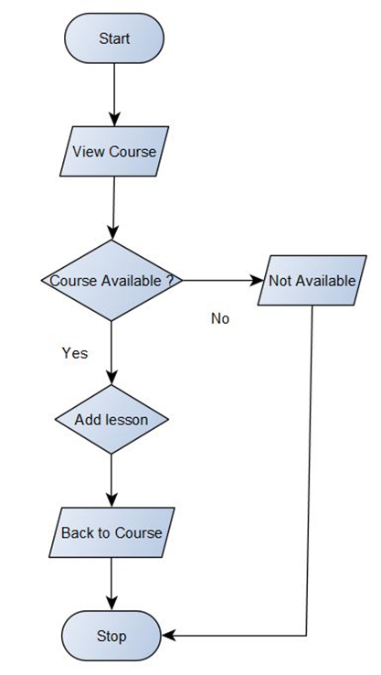
PAYMENT STATUS FLOW CHART

Slide 20
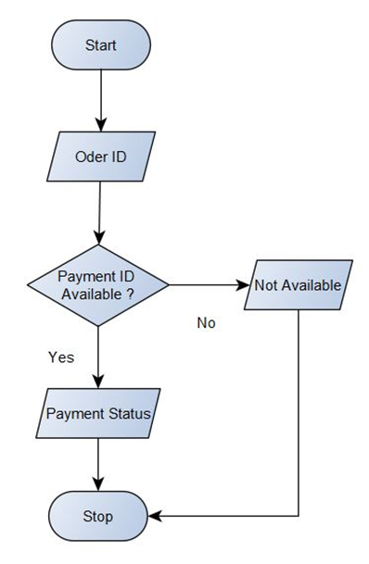
ADD LESSON FLOW CHART

Slide 21
5. WEBSITE DESIGN
5.1. Student Registration
5.2. Login / Signup
5.3. Payment Page
5.4. Home Page
5.5. Courses
5.6. Student Profile
5.7. Enrolled Courses
5.8. Feedback Form

Slide 22
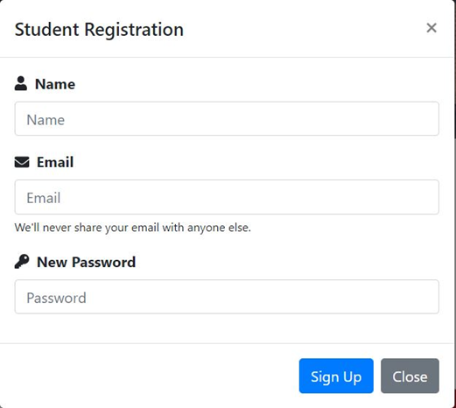
5.1. STUDENT REGISTRATION

Slide 23
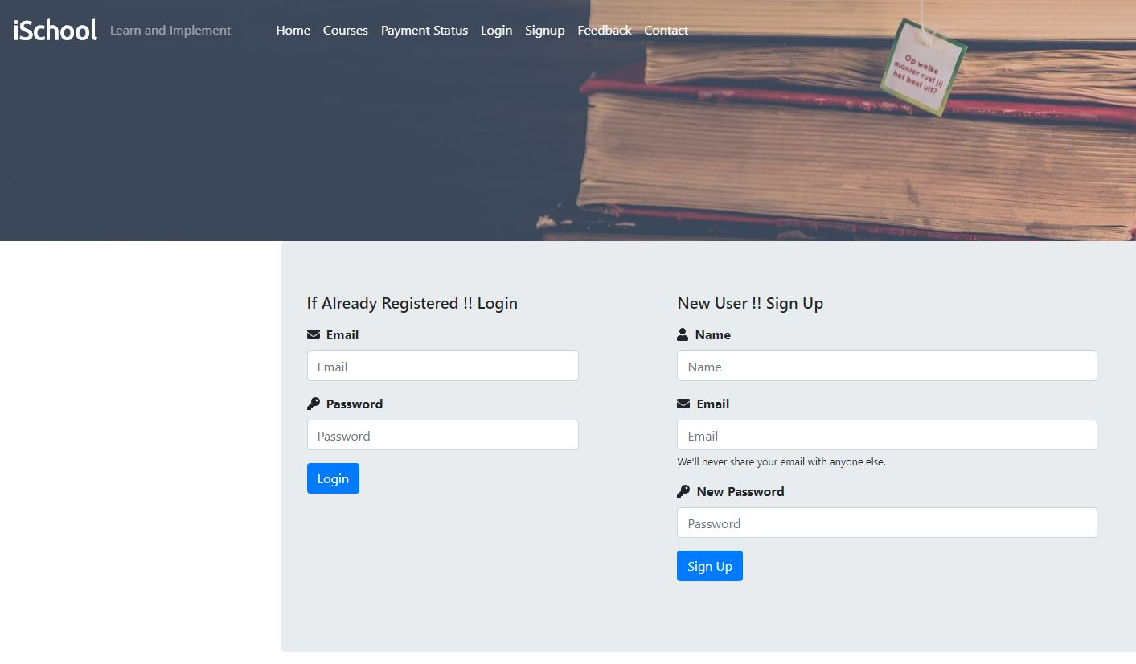
5.2. LOGIN / SIGNUP

Slide 24
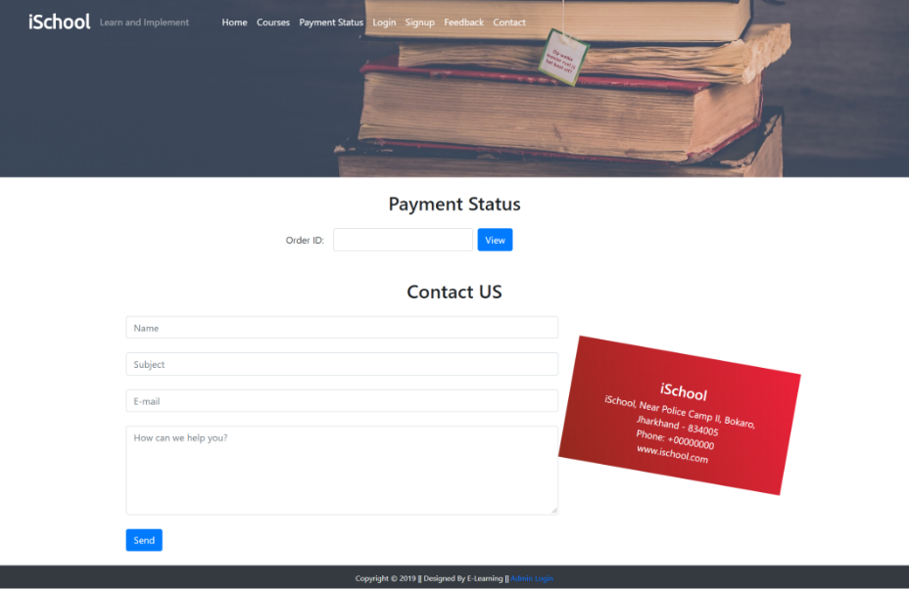
5.3. PAYMENT PAGE

Slide 25

5.4. HOME PAGE

Slide 26

5.5. COURSES

Slide 27
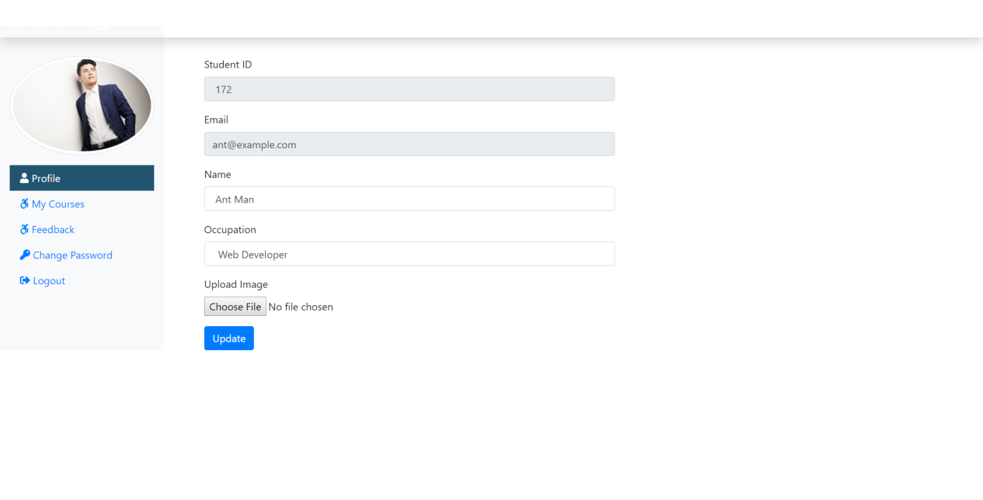
5.6. STUDENT PROFILE

Slide 28
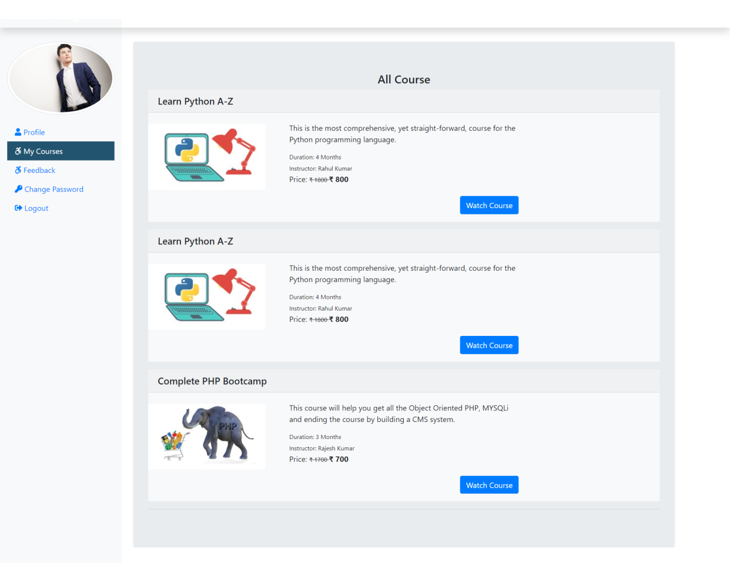
5.7. ENROLLED COURSES

Slide 29
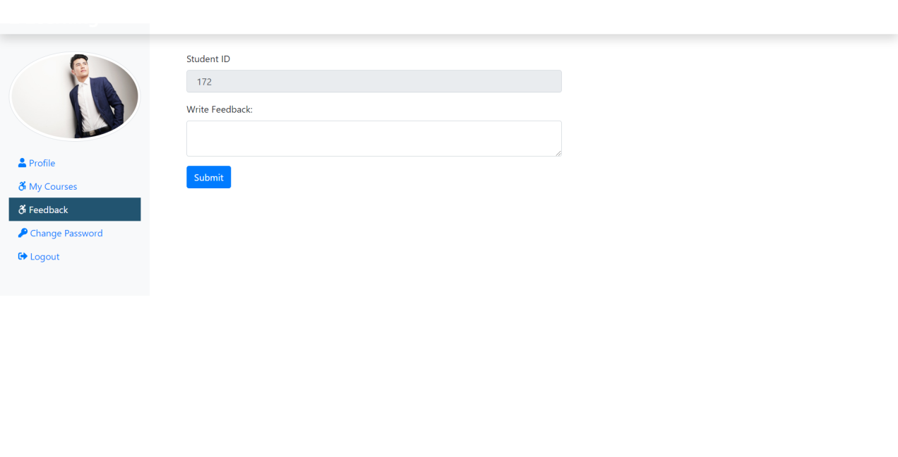
5.8. FEEDBACK FORM

Slide 30
6. DATABASE DESIGN
A data dictionary contains a list of all files in the database, the number of records in each file, and the names and types of each field. Most database management systems keep the data dictionary hidden from users to prevent them from accidentally destroying its contents
Tables:
Admin, Student, Course
Lesson, Feedback, Course Order
Each includes IDs, descriptions, and status fields

Slide 31
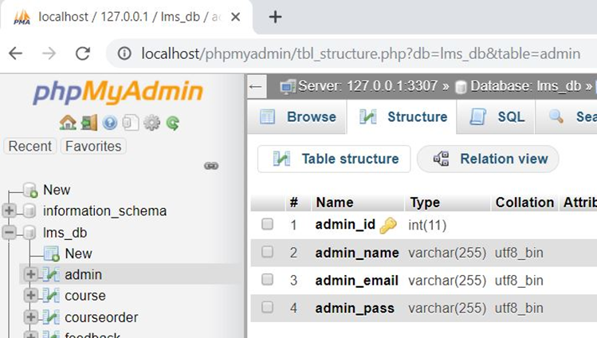
6.1. ADMIN (STORES ADMIN DETAIL)
Attribute | Data Type | Description
admin_id # | int(11) | Stores Admin ID
admin_name | varchar(255) | Stores Admin Name
admin_email | varchar(255) | Stores Admin Email ID
admin_pass | varchar(255) | Stores Admin Password

Slide 32
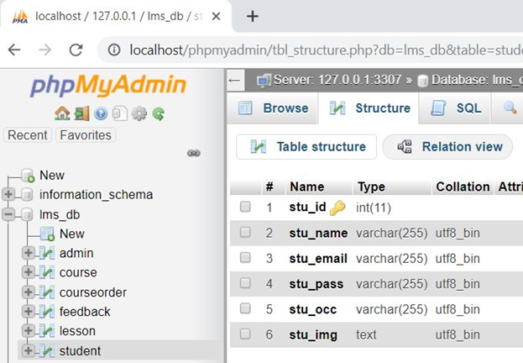
6.2. STUDENT (STORES STUDENT DETAIL)
Attribute | Data Type | Description
stu_id # | int(11) | Stores student ID
stu_name | varchar(255) | Stores student Name
stu_email | varchar(255) | Stores student Email ID
stu_pass | varchar(255) | Stores student Password
stu_occ | varchar(255) | Stores student occupation
stu_img | text | Stores student profile picture

Slide 33
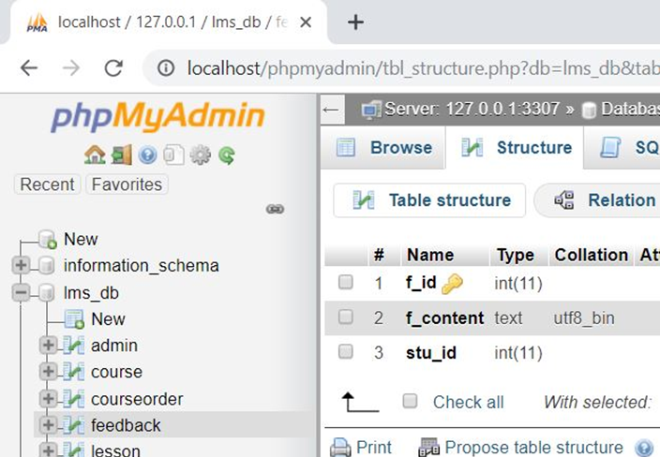
6.3. FEEDBACK (STORES FEEDBACK DETAIL)
Attribute | Data Type | Description
f_id # | int(11) | Stores Feedback ID
f_content | text | Stores Feedback content
stu_id | int(11) | Stores Student ID

Slide 34
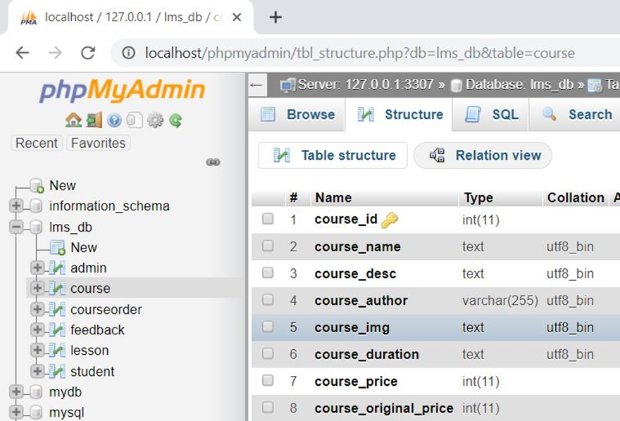
6.4. COURSE (STORES COURSE DETAIL)
Attribute | Data Type | Description
course_id # | int(11) | Stores Course ID
course_name | text | Stores course Name
course_desc | text | Stores course description
course_author | varchar(255) | Stores course author/instructor
course_img | text | Stores course display picture
course_duration | text | Stores course duration
course_price | int(11) | Stores course selling price
course_original_price | int(11) | Stores course original price

Slide 35
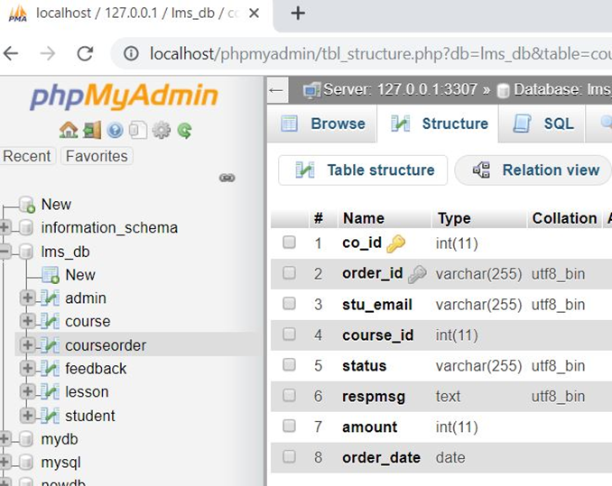
6.5. courseorder (STORES COURSE ORDER DETAIL)
Attribute | Data Type | Description
co_id # | int(11) | Stores course order ID
order_id | varchar(255) | Stores Order ID (Random)
stu_email | varchar(255) | Stores student email id
course_id | int(11) | Stores course id
status | varchar(255) | Stores payment status
respmsg | text | Stores payment response msg
amount | int(11) | Stores course amount
order_date | Date | Stores purchase date

Slide 36
7.Motivation
1.📚 Bridging the Education-Industry Gap:
The project aims to connect academic learning with real-world skills by offering practical, job-oriented online courses.
2.🌐 Digital Accessibility:
To provide learners across diverse regions with easy access to educational resources via a user-friendly online platform.
3.🧑‍🎓 Empowering Students:
Encouraging self-paced learning and enabling students to manage their educational journey with flexibility and control.

Slide 37
4.⚙️ Simplified Administration:
To help institutions and course providers efficiently manage courses, enrollments, feedback, and student progress using a centralized admin panel.
5.🚀 Real-World Application:
Developed as part of a live internship with Unified Mentor, allowing practical exposure to modern web technologies and project workflows.

Slide 38
8. CONCLUSION
Strengths:
User-friendly UI
Easily scalable
Secure and simple
Limitations:
No live chat, no multilingual support
No certification or quiz modules yet

Slide 39

THANK YOU
- Priyanka Marathe

